Slide 1
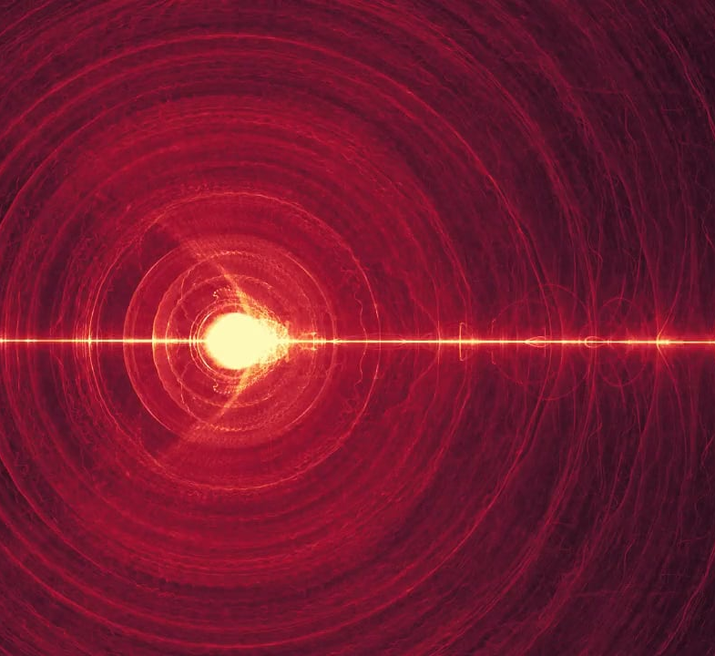

SPCE 5065 RADIATION ENVIRONMENT
ALL THAT REMAINED NOW WAS THE DISTRIBUTION OF THE ENERGY ALREADY RELEASED BY NATURAL LAWS WHICH NEITHER KNEW NOR CARED ABOUT THE PURPOSES OF THEIR MANIPULATORS.
TOM CLANCY, THE SUM OF ALL FEARS
Part 1:
Sources
Human effects
Solar radiation pressure
Part 2:
Basic radiation physics
Part 3: More on radiation

Slide 2
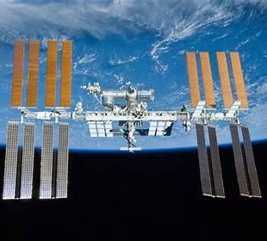

Jason Ansley
HW Problem 1 PART a
Write:
Summarize the presentation
2) Describe something you learned from it
3) Write one question you have left about the presentation

Slide 3
Fanita Pfau
HW Problem 1 PART b
Write:
Summarize the presentation
2) Describe something you learned from it
3) Write one question you have left about the presentation

Slide 4
Rachel Danover
HW Problem 1 PART c
Write:
Summarize the presentation
2) Describe something you learned from it
3) Write one question you have left about the presentation

Slide 5
Moyiwa Adewumi
HW Problem 1 PART d
Write:
Summarize the presentation
2) Describe something you learned from it
3) Write one question you have left about the presentation

Slide 6
Impact of the Space Environment on Spacecraft Systems
Space Environments
Vacuum | Neutral | Plasma | Radiation | MM/OD
Spacecraft Subsystems | Solar UV | Outgassing/ Contamination | Aerodynamic Drag | Sputtering | Atomic Oxygen | Spacecraft Glow | Spacecraft Charging | Van Allen Belts | Galactic Cosmic Rays | Solar Proton Events | Impacts
Attitude Determination & Control |  | Degradation of sensors | Induced torques |  |  | Interference with sensors | Torques due to induced potentials
Avionics |  |  |  |  |  |  | Upsets due to EMI from arcing |  |  |  | EMI due to impacts
Electrical Power |  |  |  |  |  |  | Shift in floating potential, reattraction of contaminants |  |  |  | Destruction/ obscuration of solar cells
Propulsion |  | Thruster plumes may be a contaminant source | Drag makeup fuel requirement |  |  |  | Shift in floating potential due to thruster firings |  |  |  | Rupture of pressurized tanks
Structures |  |  |  |  |  |  |  |  |  |  | Penetration
Telemetry, Tracking & Communications |  | Degradation of sensors |  |  |  | Interference with sensors | EMI due to arcing |  |  |  | EMI due to impacts
Thermal Control |  |  |  |  |  |  | Reattraction of comtaminants |  |  |  | Degradation of alpha/epsilon
Change in sensor coatings
Degradation: SEUs, bit errors, …
Change in coverslide transmittance
Change in coverslide transmittance
Degradation of solar cell output
Change in sensor coatings
Degradation of electronics
Change in surface alpha/epsilon ratio
Change in surface alpha/epsilon ratio
Cold surfaces may experience heating
TSE, Fig 7.1
Notes:
A variety of environmental effects have a direct impact on the ability of spacecraft subsystems to execute their design objectives
This chart provides a good summary of the impacts of the space environment on these subsystems
⇒ we’ll walk through each of these areas in the next several slides
Must recognize that extra margin must be designed into spacecraft subsystems to handle these impacts

Slide 7
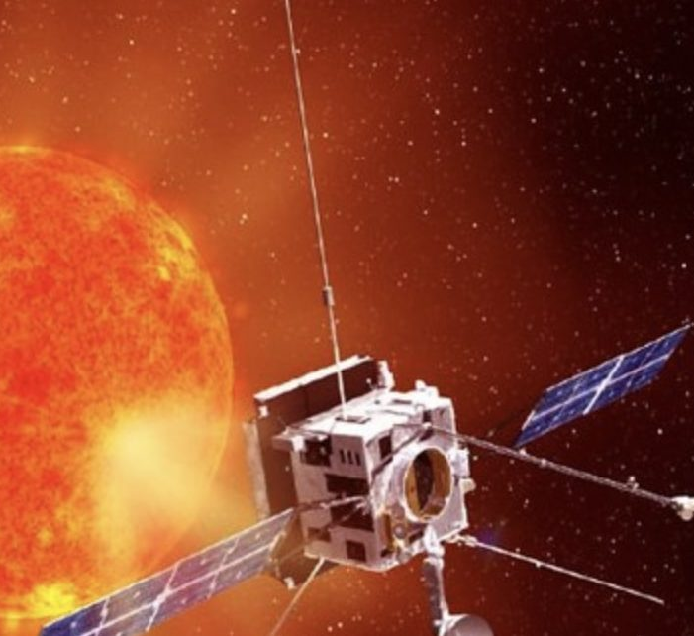
Radiation Environment and Its Effects
Radiation is any object that deposits energy in a material
Charged particles (electrons, protons)
Uncharged particles (neutrons)
Photons (gamma rays, x-rays)
Notes:
Energy transfer vs. charging
Energetic particles may displace or ionize material in their paths (also deposit energy to induce more low energy effects)
Dominant source depends on orbit
A variety of naturally occurring sources exist
Ionization and atomic displacement reduce the current and power that a cell can produce
Similar to solar cell degradation
No response to inputs
Functions in a manner inconsistent with its design characteristics (e.g., memory register changes state)
“soft” -- bit flips
“hard” -- permanent damage

Slide 8
TYPES
NON-IONIZING
IONIZING

Slide 9
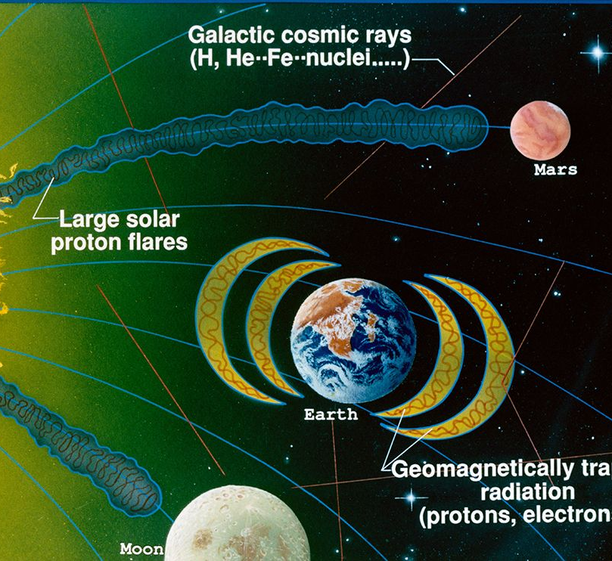
RADIATION ENVIRONMENT
MAJOR Radiation sources
Solar particle events (SPE), highest during peaks in the solar cycle
Trapped radiation in the Van Allen Belts
Galactic cosmic rays (GCR): mostly hydrogen and helium ions
Nuclear blasts in space
Things we carry with us
Notes:
Energy transfer vs. charging
Energetic particles may displace or ionize material in their paths (also deposit energy to induce more low energy effects)
Dominant source depends on orbit
A variety of naturally occurring sources exist
Ionization and atomic displacement reduce the current and power that a cell can produce
Similar to solar cell degradation
No response to inputs
Functions in a manner inconsistent with its design characteristics (e.g., memory register changes state)
“soft” -- bit flips
“hard” -- permanent damage

Slide 10
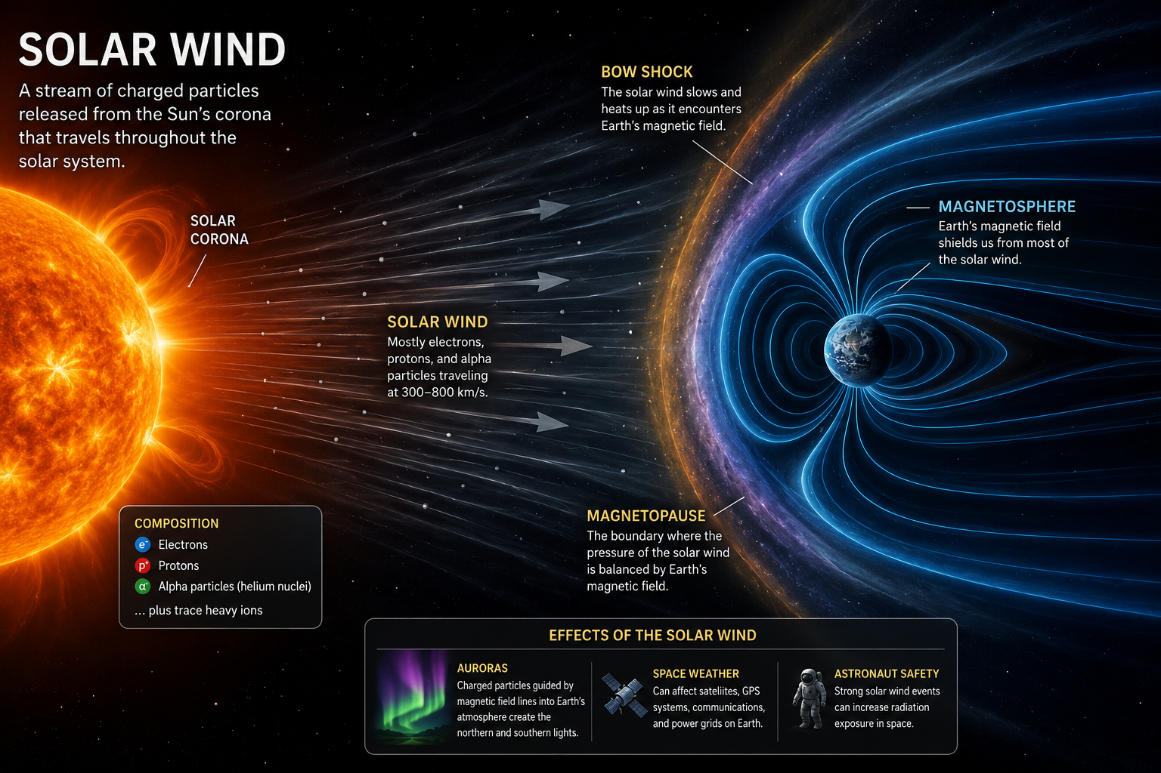



Slide 11
Solar Particle Events
Solar radiation storm scale:
Typical time evolution of an event observed on Earth:
Category | Effects on Satellite Operators
S-5: Extreme | Total loss of some satellites; permanent damage to solar panels; memory device problems cause loss of control, serious noise in image data; star trackers unable to locate sources.
S-4: Severe | Memory device problems; noise in imaging systems; interference with star trackers cause orientation problems; degradation of solar panels.
S-3: Strong | Noise in imaging systems; permanent damage to exposed components and detectors; decrease of current generated by solar panels
S-2: Moderate | Infrequent, isolated problems
S-1: Minor | None
10⁴
Protons > 29 MeV
Shock
10³
10²
Relative Units
X-Rays 1-8 
10¹
Protons > 500 MeV
10⁰
1
10
100
1 day
2 days
1 week
Time (Hours)
SMAD, Fig 8.11
Typical timeline of emissions from a solar eruptive event, illustrating the arrival of X-rays, solar energetic protons, and the associated interplanetary shock over time.
Event activity peaks within a year or two of a sunspot maximum and diminishes greatly during the few years surrounding a sunspot minimum
Adapted from Space News (Nov. 22, 1999 – Pg 3)
Notes:
Intense solar activity can be expected for about 3 years after its peak in March 2001
Helps to familiarize satellite owners with solar events and the problems they pose for sensitive electronics
(new satellite operators have emerged in recent years who have yet to experience a solar maximum)

Slide 12
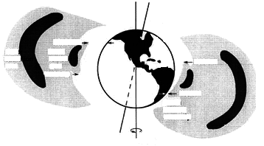
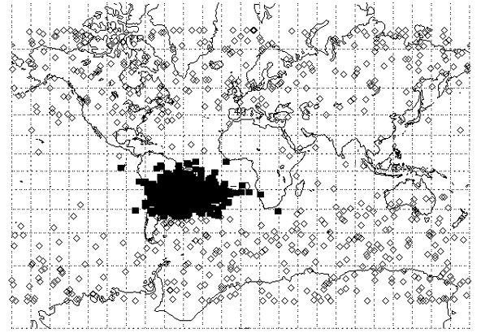
The Van Allen Radiation Belts
Magnetic
Axis
1200 km
Outer
Belt
Inner
Belt
800 km
1300 km
200 km
South
Atlantic
Anomaly
Earth’s
Rotational Axis
http://aoss.engin.umich.edu/earth_space/
courtesy of The Aerospace Corporation
Radiation belts define a natural upper limit to “low-Earth orbit” of ~ 900 km
Electron Belts (E > 0.5 MeV)
SMAD, Fig 8.7
Proton Belt (E > 100 MeV)
SMAD, Fig 8.8
The South Atlantic Anomaly: Single Event Upsets
on the
USAF Technology Autonomous Operational Survivability (TAOS) satellite
http://envnet.gsfc.nasa.gov/
Papers/Reno98.html
Notes:
The Earth’s magnetic field creates a “force field” to protect us from thes energetic particles, but …
some are trapped to gyrate back and forth along the Earth’s magnetic field lines (Van Allen radiation belts)
-- two regions of electrons (peak densities at 3000 km and 25000 km)
-- one region of protons (peak density at 3000 km)
Van Allen belt effects tend to be most significant in polar orbits
550 km, nearly polar orbit
47% of SEUs occurred in the South Atlantic Anomaly despite the fact that only 5% of the total orbital time was spent in this area

Slide 13
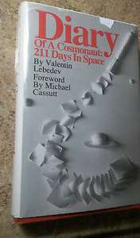
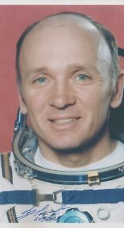
EXAMPLE

Slide 14
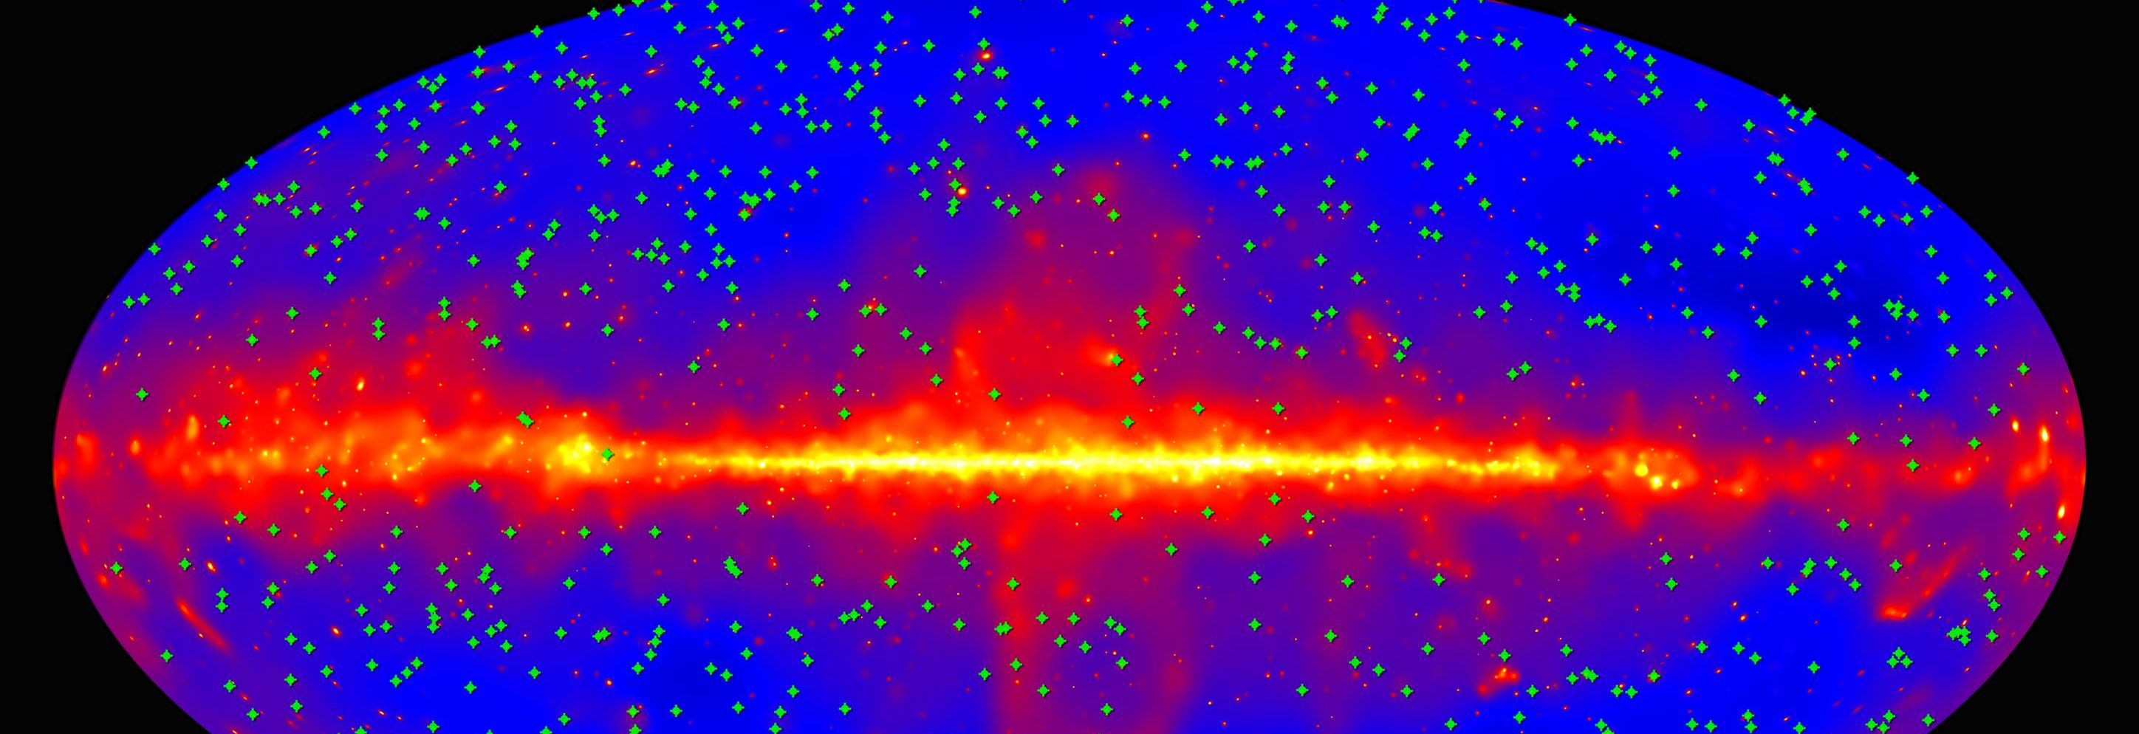
GALACTIC COSMIC RAYS

Slide 15
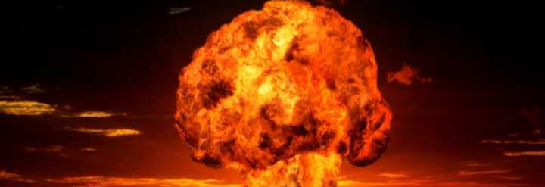
NUCLEAR DETONATIONS

Slide 16
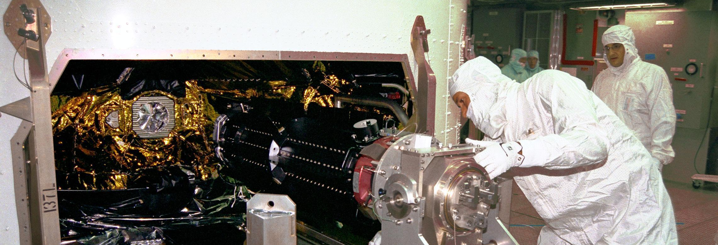
RTGS

Slide 17
RADIOBIOLOGY
Acute and late central nervous system effects
Acute radiation syndromes due to spes
Cardiovascular disease/degenerative tissue
Radiation carcinogenesis

Slide 18

RADIATION DEFINITIONS
RADIOBIOLOGY
- DETERMINISTIC
- STOCHASTIC
ALARA

Slide 19
RADIATION DEFINITIONS - UNITS
ACTIVITY
EXPOSURE
ROENTGEN
RAD
GRAY
SAR

Slide 20

RADIATION ENVIRONMENT DEFINITIONS
Absorbed dose (d)
Gray
Equivalent dose ($H_{T})$
Sievert
RBE
RAD
REM (Roentgen Equivalent Man)
REM = RAD * RBE

Slide 21
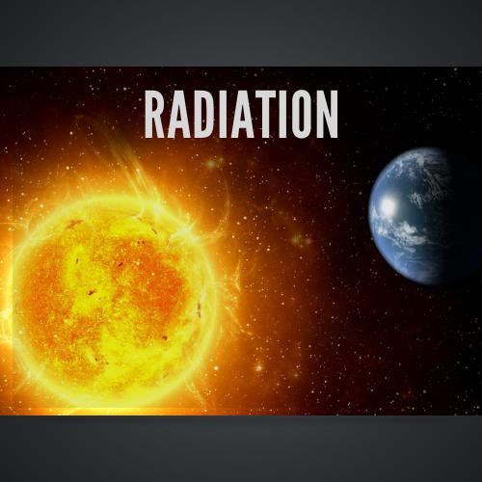
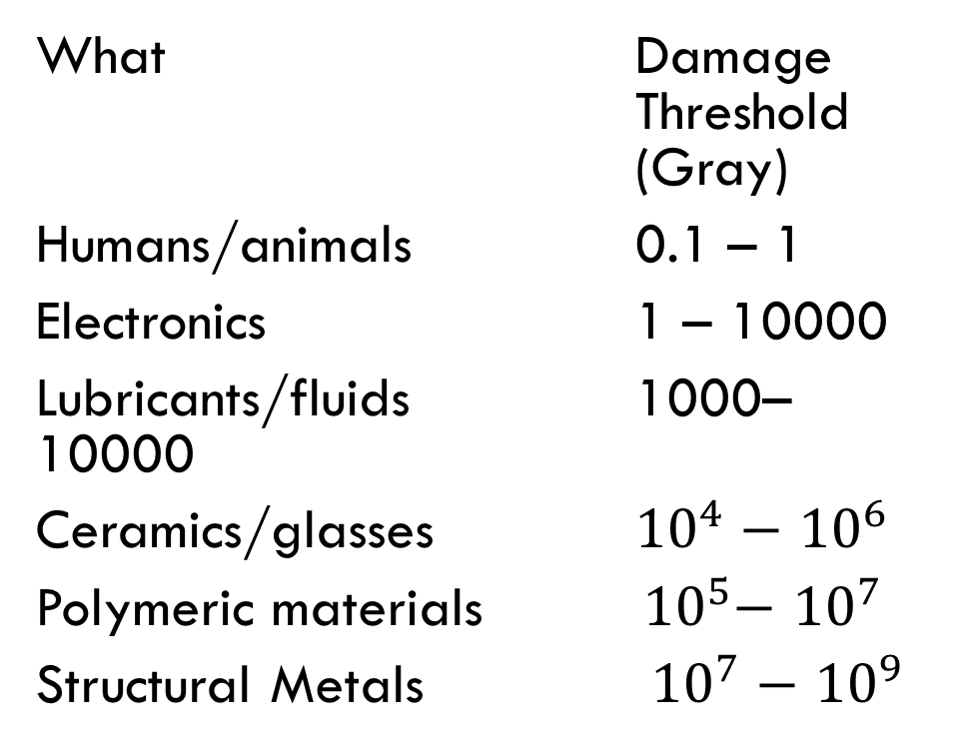
DOSE LEVELS
What RBE
EM Radiation at Earth 1
Radiation Belts 5 – 7
Charged Particles 10
What Damage Threshold (Gray)
Humans/animals 0.1 – 1
Electronics 1 – 10000
Lubricants/fluids 1000–10000
Ceramics/glasses ${10}^{4}−$ ${10}^{6}$
Polymeric materials ${ 10}^{5}−$ ${10}^{7}$
Structural Metals ${10}^{7}−$ ${10}^{9}$

Slide 22
DOSE LEVELS AND EFFECTS
Career Space Permissible Exposure Limit for Space Flight Radiation. An individual astronaut’s total career effective radiation dose due to space flight radiation exposure shall be less than 600 mSv. This limit is universal for all ages and sexes.
NASA STD 3001
LIFE LIMIT = 600 mSv (60 REM)
ACUTE EXPOSURE (SHORT TERM)
ACUTE EXPOSURE (LONG TERM)

Slide 23
TYPICAL EXPOSURE LEVELS
WHERE TYPICAL LEVEL (REM)
Sea level 0.1/year
Colorado Springs 0.2/year
Chest xray 0.01/year
Transcontinental flight 0.004/year
Skylab 84 days 17.85 (78/yr)
Shuttle 80 days 8.71 (40/yr)
ISS 80 days 4 (18/yr)
REM EFFECT
5 – 10 Radiation sickness (5 – 10%)
10 – 15 Radiation sickness (25%)
15 – 20 Radiation sickness (50%)
15 – 50 Blood count changes
100 Vomiting
150 Mortality (5 – 25%)
320 – 360 Mortality (50%)
480 – 540 Mortality even with care (50%)
1000 No survivors
LIFE LIMIT = 600 mSv (60 REM)

Slide 24

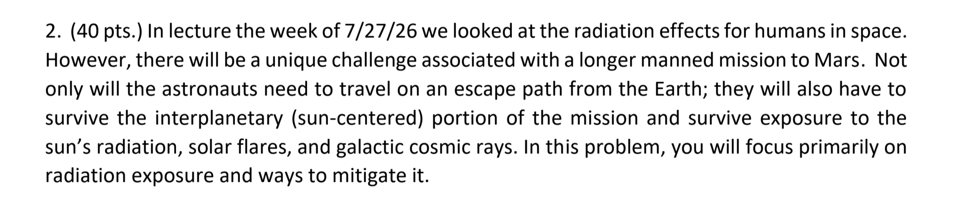
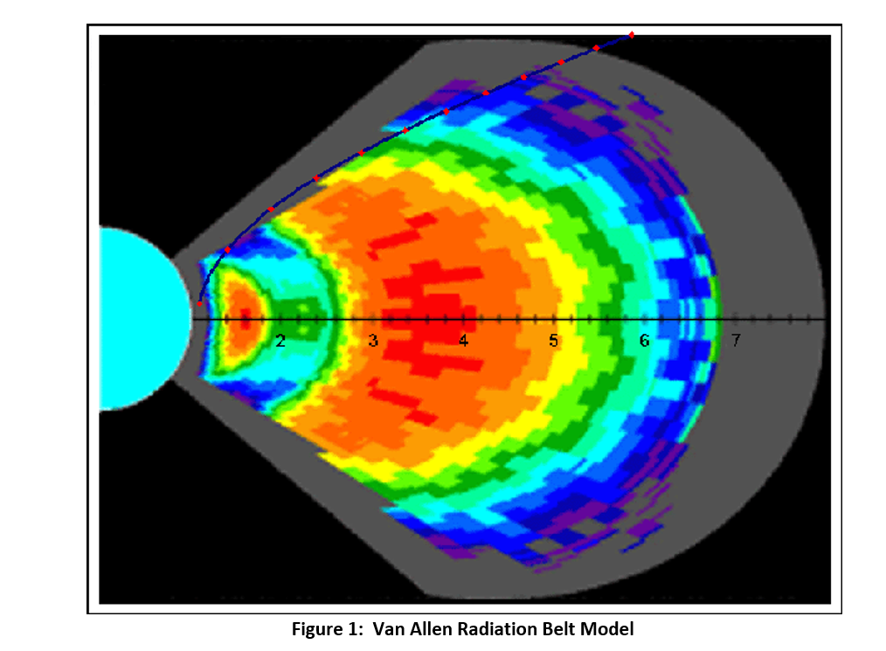

Slide 25
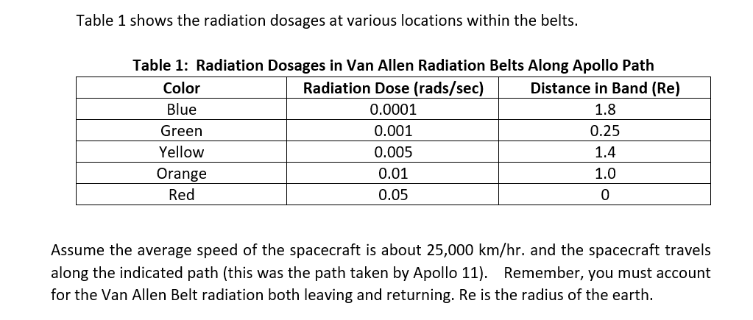
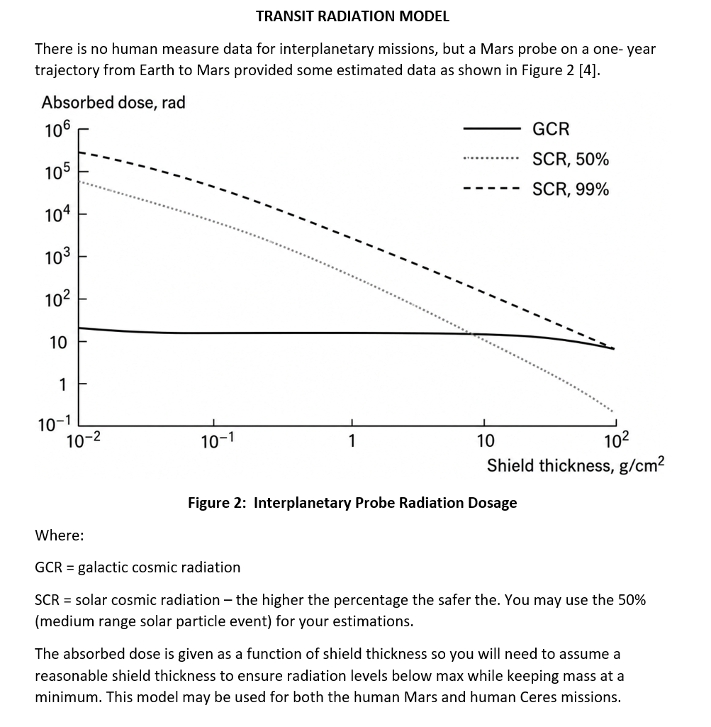
HOMEWORK PROBLEM 2

Slide 26
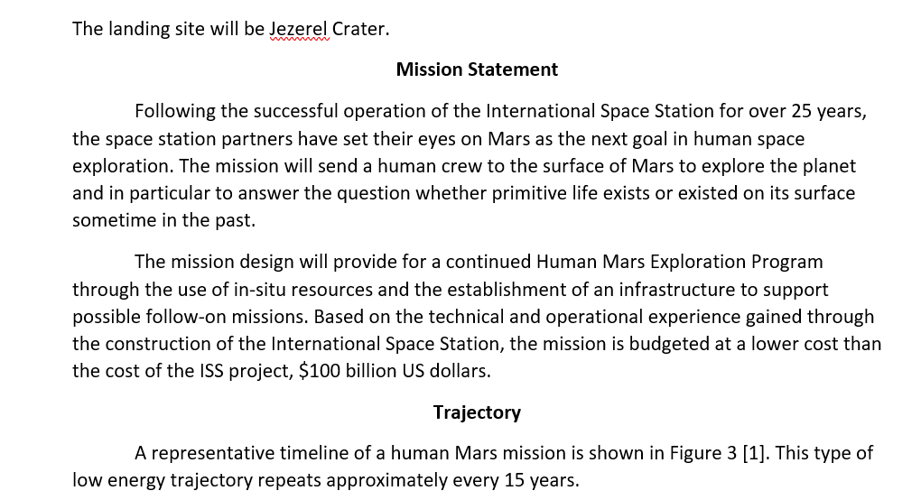
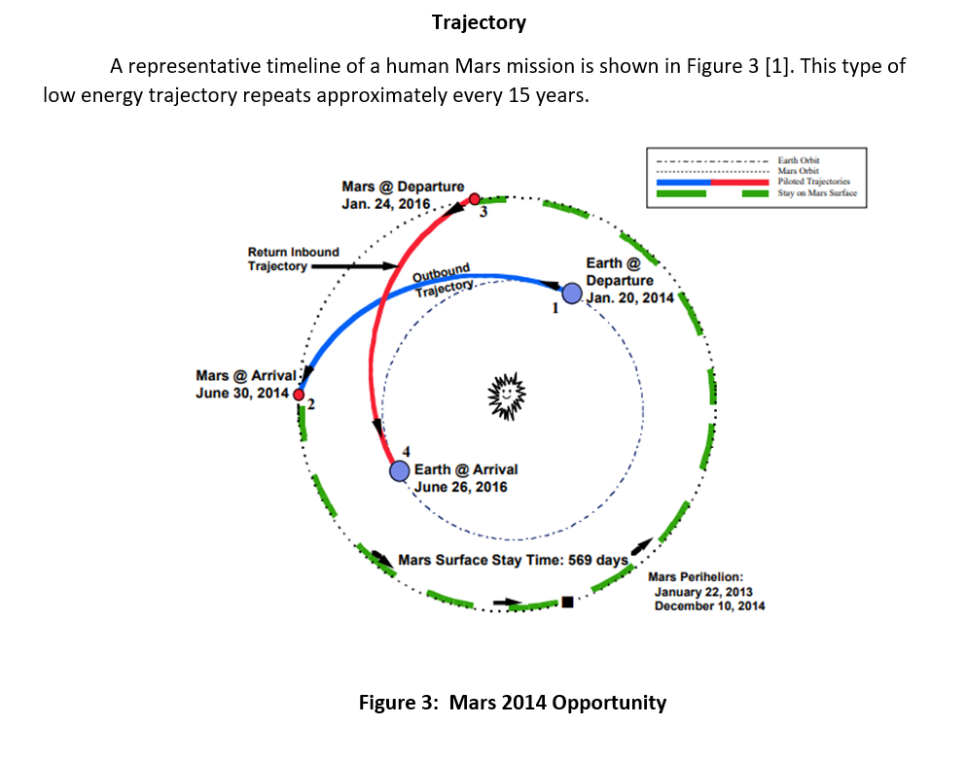
Homework PROBLEM 2

Slide 27
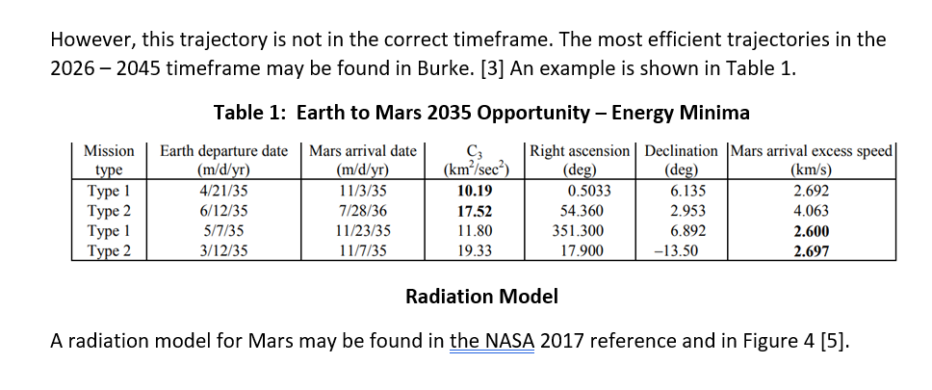
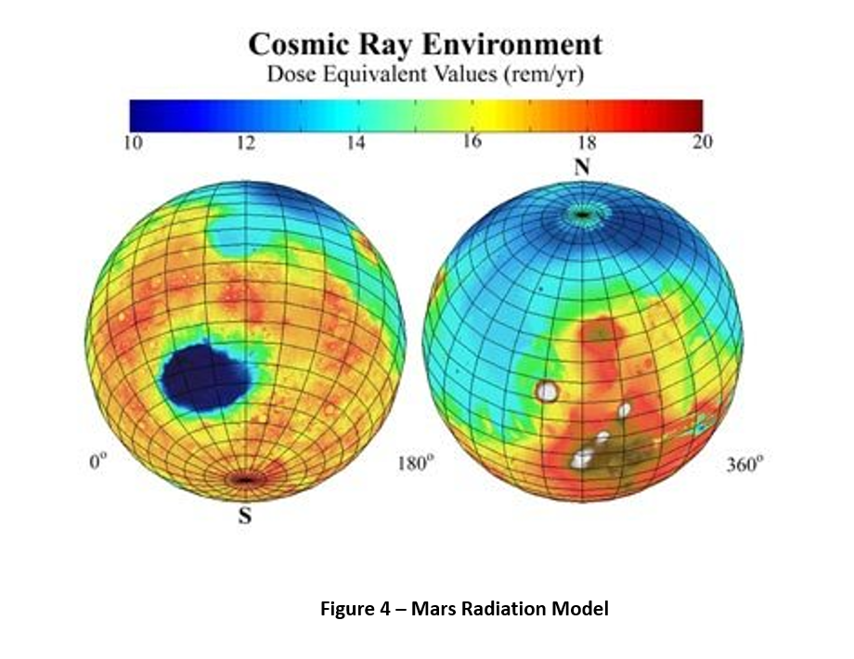
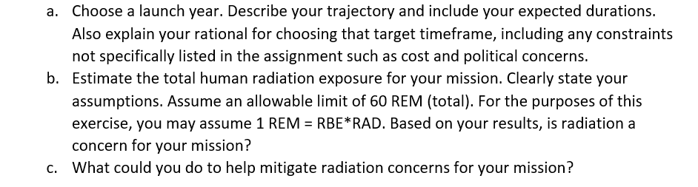
Homework problem 2 (cont)

Slide 28
REFERENCES
Braeunig, Robert A. (2013.) Rocket and Space Technology. Atmospheric Properties.
Cosgrove, A. (2014, September 12). Web exclusive: Potential impact of solar flares. Facility Executive. Retrieved July 10, 2022, from Potential impact of solar flares
ESA. (19 June 2017.) Magnetic Space Tug Could Target Dead Satellites.
The largest nuclear test in outer space had startling effects on Hawaii. (n.d.). Retrieved July 11, 2022, from https://www.realclearscience.com/blog/2020/01/14/the_largest_nuclear_test_in_outer_space_had_startling_effects_on_hawaii.html
Nasa Biosphere Science Research Portal. (2 June 2017.) Research Highlights Feb 2016.
OpenAI, ChatGPT (GPT-5.5) with DALL·E image generation, "Solar Wind Illustration," AI-generated image, July 25, 2026. Slide 9
Space Propulsion. (2017.) Propellant Tanks.
Tran, L. (2020, July 31). NASA Sun Data helps new model predict big solar flares. NASA. Retrieved July 10, 2022, from https://www.nasa.gov/feature/goddard/2020/nasa-sdo-sun-data-helps-new-model-predict-big-solar-flares

